Slide 1
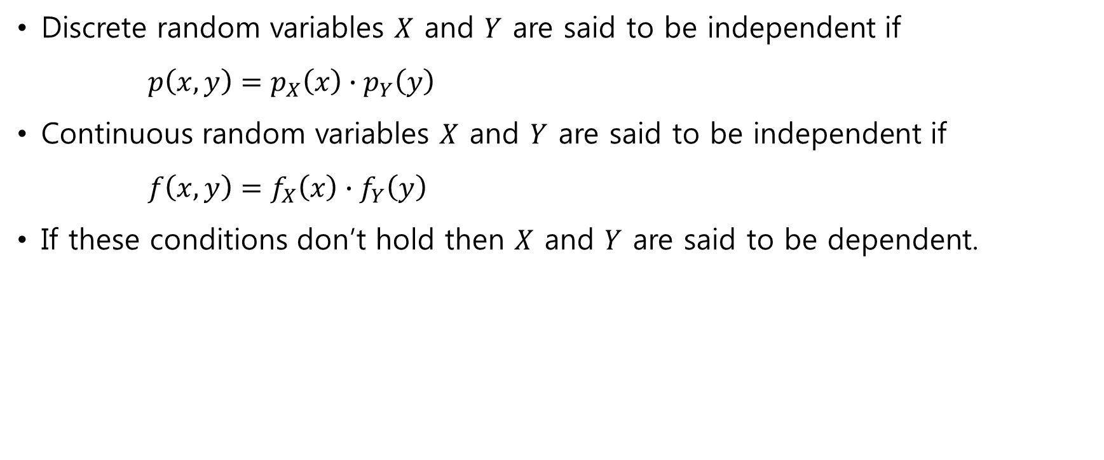
Independent Random Variables
Discrete random variables $X$ and $Y$ are said to be independent if
$p\left(x, y\right)=p_{X}\left(x\right)∙p_{Y}\left(y\right)$
Continuous random variables $X$ and $Y$ are said to be independent if
$f\left(x, y\right)=f_{X}\left(x\right)∙f_{Y}\left(y\right)$
If these conditions don’t hold then $X$ and $Y$ are said to be dependent.

Slide 2
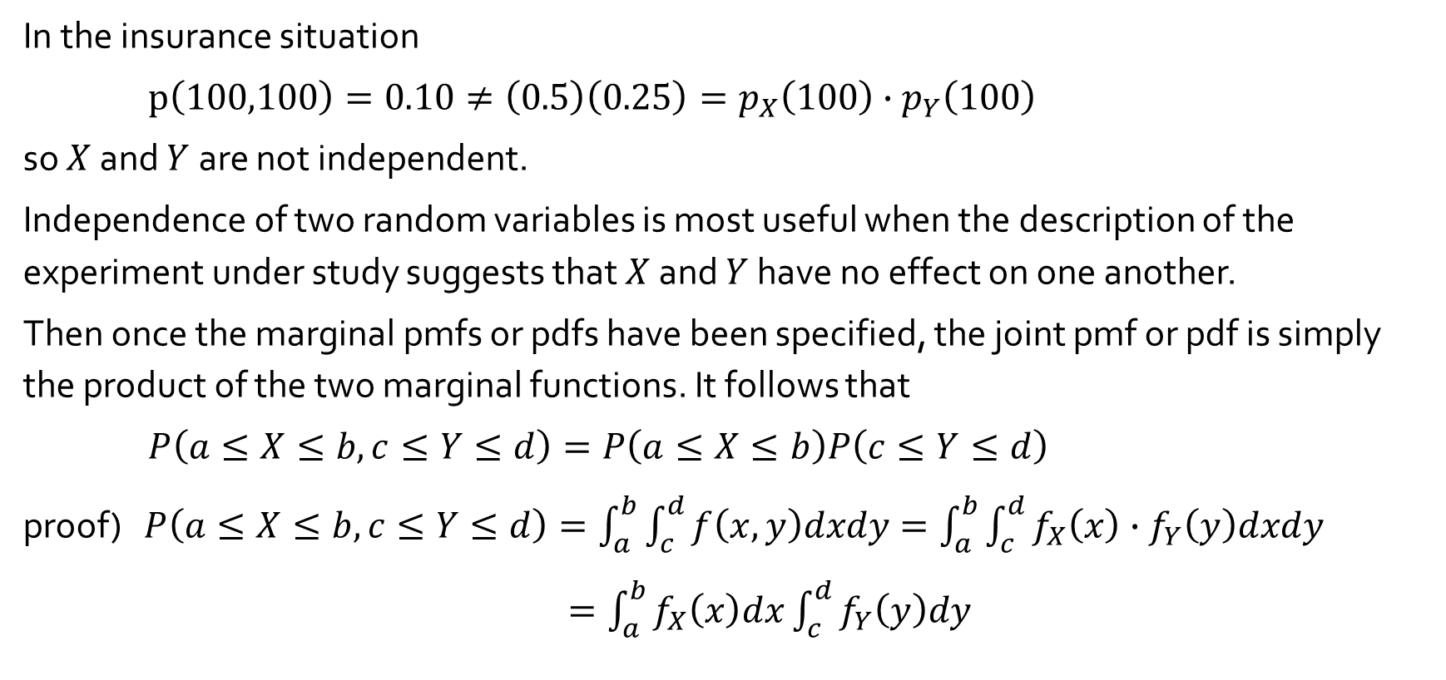
Two Continuous Random Variables - Examples
In the insurance situation
$p\left(100,100\right)=0.10≠\left(0.5\right)\left(0.25\right)=p_{X}\left(100\right)∙p_{Y}\left(100\right)$
so $X$ and $Y$ are not independent.
Independence of two random variables is most useful when the description of the experiment under study suggests that $X$ and $Y$ have no effect on one another.
Then once the marginal pmfs or pdfs have been specified, the joint pmf or pdf is simply the product of the two marginal functions. It follows that
$P\left(a≤X≤b,c≤Y≤d\right)=P\left(a≤X≤b\right)P\left(c≤Y≤d\right)$
proof) $P\left(a≤X≤b,c≤Y≤d\right)=\int_{a}^{b}{\int_{c}^{d}{f\left(x, y\right)dxdy}}=\int_{a}^{b}{\int_{c}^{d}{f_{X}\left(x\right)∙f_{Y}\left(y\right)dxdy}}$
$=\int_{a}^{b}{f_{X}\left(x\right)dx\int_{c}^{d}{f_{Y}\left(y\right)dy}}$

Slide 3
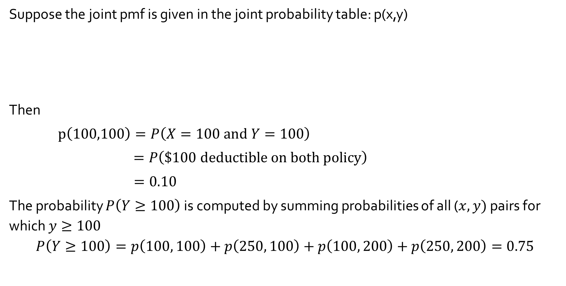
Two Discrete Random Variables - Examples
Suppose the joint pmf is given in the joint probability table: p(x,y)
Then
$p\left(100,100\right)=P\left(X=100 and Y=100\right)$
$=P\left(\$100 deductible on both policy\right)$
$=0.10$
The probability $P\left(Y≥100\right)$ is computed by summing probabilities of all ($x, y)$ pairs for which $y≥100$
$$P\left(Y≥100\right)=p\left(100, 100\right)+p\left(250, 100\right)+p\left(100, 200\right)+p\left(250, 200\right)=0.75$$
y
 |  | 0 | 100 | 200
x | 100 | 0.20 | 0.10 | 0.20
 | 250 | 0.05 | 0.15 | 0.30

Slide 4
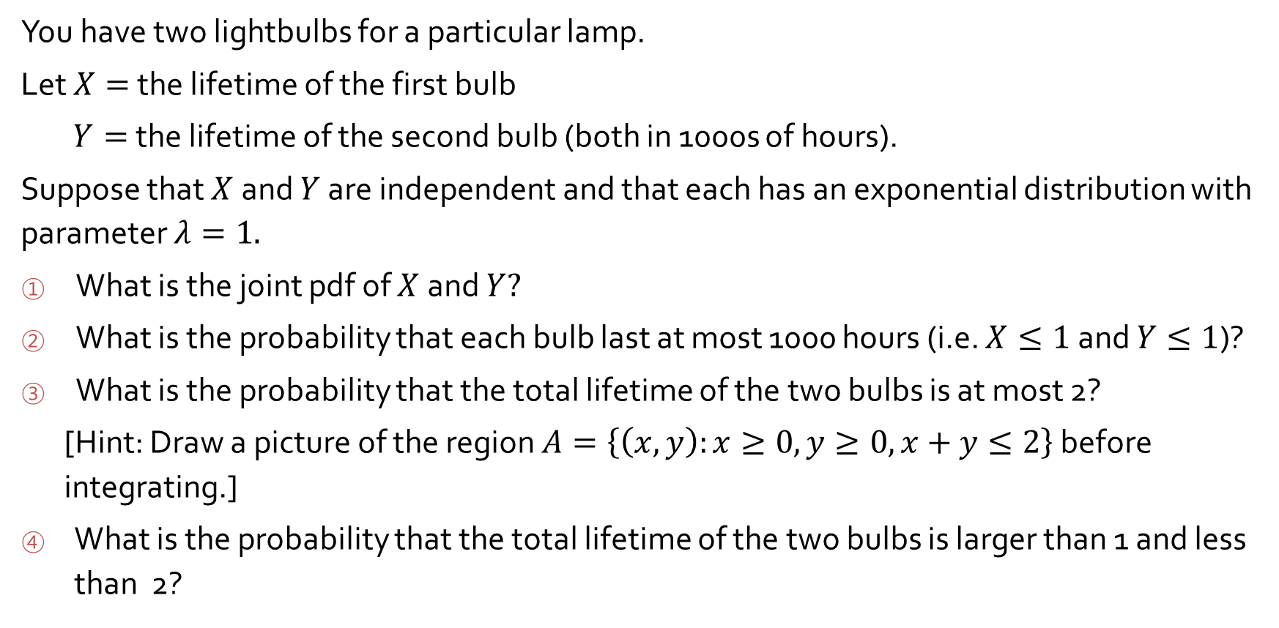
Exercise 5.1 #19
You have two lightbulbs for a particular lamp.
Let $X=$ the lifetime of the first bulb
$Y=$the lifetime of the second bulb (both in 1000s of hours).
Suppose that $X$and $Y$ are independent and that each has an exponential distribution with parameter $λ=1.$
What is the joint pdf of $X$and $Y?$
What is the probability that each bulb last at most 1000 hours (i.e. $X≤1$ and $Y≤1$)?
What is the probability that the total lifetime of the two bulbs is at most 2?
[Hint: Draw a picture of the region $A=\left\{\left(x, y\right):x≥0,y≥0,x+y≤2\right\}$ before integrating.]
What is the probability that the total lifetime of the two bulbs is larger than 1 and less than 2?

Slide 5

The joint pdf is
${f\left(x, y\right)=f}_{X}\left(x\right)∙f_{Y}\left(y\right)$ $f\left(x\right)=λe^{−λx} x>0$
$=\left\{\begin{matrix}e^{−x}∙e^{−y}=e^{−x−y} & x>0, y>0 \\ 0 & otherwise\end{matrix}\right.$
$P\left(X≤1, Y≤1\right)=P\left(X≤1\right)∙P\left(Y≤1\right)$
$=\int_{0}^{1}{e^{−x}dx∙}\int_{0}^{1}{e^{−y}dy}=\left.(−e^{−x})\right|\begin{matrix}x=1 \\ x=0\end{matrix}$ $∙\left.(−e^{−y})\right|\begin{matrix}y=1 \\ y=0\end{matrix}$
$=\left(1−e^{−1}\right)$ $∙ \left(1−e^{−1}\right)$=0.3996
$$\left(\int{e^{ax}=\frac{1}{a}}e^{ax}, \frac{d}{dx}e^{f(x)}=e^{f(x)}f^{′}\left(x\right), \int{{f^{′}\left(x\right)e}^{f(x)}dx=e^{f(x)}}\right)$$

Slide 6
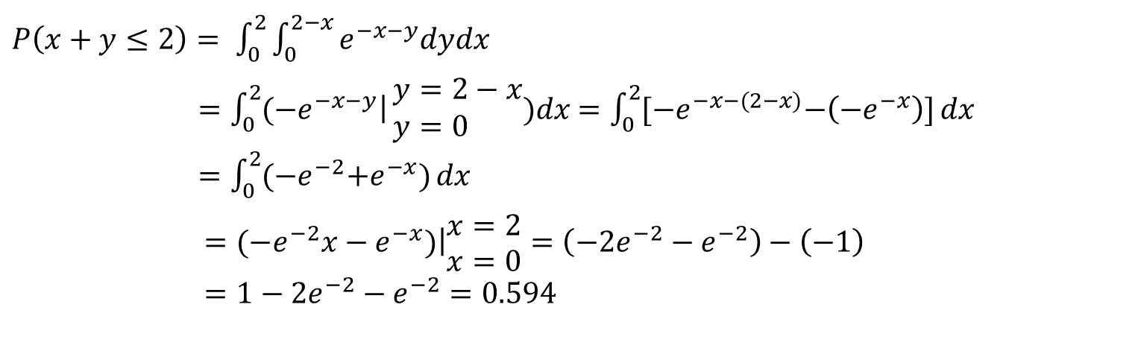
$P\left(x+y≤2\right)= \int_{0}^{2}{\int_{0}^{2−x}{e^{−x−y}dydx}}$
$=\int_{0}^{2}{\left.(−e^{−x−y}\right|}\begin{matrix}y=2−x \\ y=0 \end{matrix})dx$ $=\int_{0}^{2}{{[−e}^{−x−(2−x)}−\left(−e^{−x}\right)]}dx$
$=\int_{0}^{2}{{(−e}^{−2}+e^{−x})}dx$
$=\left.{(−e}^{−2}x−e^{−x})\right|\begin{matrix}x=2 \\ x=0\end{matrix}=\left(−2e^{−2}−e^{−2}\right)−\left(−1\right)$
$=1−2e^{−2}−e^{−2}=0.594$
2
2-x
x+y=2
x
2

Slide 7

$P\left(1<x+y<2\right)=P\left(x+y<2\right)−P\left(x+y<1\right)$
$P\left(x+y<1\right)=\int_{0}^{1}{\int_{0}^{1−x}{e^{−x−y}dydx}}$
$=\int_{0}^{1}{\left.(−e^{−x−y}\right|}\begin{matrix}y=1−x \\ y=0 \end{matrix})dx=\int_{0}^{1}{{(−e}^{−1}+e^{−x})}dx$
$=\left.{(−e}^{−1}x−e^{−x})\right|\begin{matrix}x=1 \\ x=0\end{matrix}=\left(−e^{−1}−e^{−1}\right)−\left(−1\right)$
$=1−2e^{−1}=0.264$
$P\left(1<x+y<2\right)=0.594−0.264=0.33$
or
$P\left(1<x+y<2\right)$
$=\int_{0}^{1}{\int_{1−x}^{2−x}{e^{−x−y}dydx}}$ $+\int_{1}^{2}{\int_{0}^{2−x}{e^{−x−y}dydx}}$
2
x+y=1
x+y=2
2

